Slide 1
Pitch Perception of Pure tones
Pitch perception
Limits to pitch discrimination
Place theory
-von Bekesy
-limitations
Temporal Theory
-described
-limits
-phase locking and volley principle

Slide 2
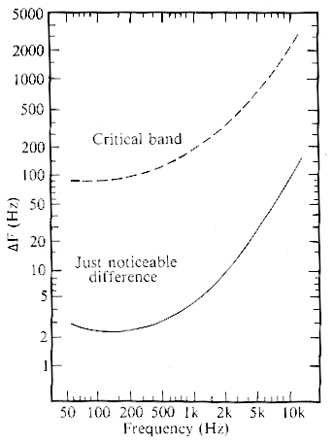
Pitch discrimination: jnd values vary depending on frequency
-correspond closely to critical band values
(play 300, 1000, 4000 Hz delta-f examples)

Slide 3
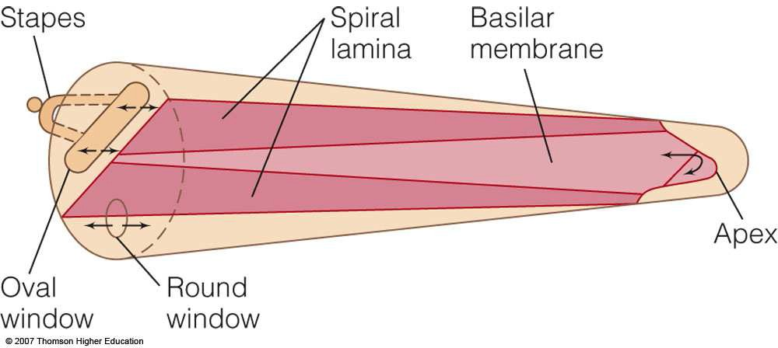
Békésys’ Place Theory of Hearing
Physical properties of the basilar membrane
Base of the membrane (by stapes) is
3 to 4 times narrower than at the apex
100 times stiffer than at the apex
Both the model and the direct observation showed that the vibrating motion of the membrane is a traveling wave

Slide 4
Békésys’ Place Theory of Hearing
Frequency of sound is indicated by the place on the organ of Corti that has the highest firing rate
Békésy determined this in two ways
Direct observation of the basilar membrane in a cadaver
Building a model of the cochlea using the physical properties of the basilar membrane

Slide 5
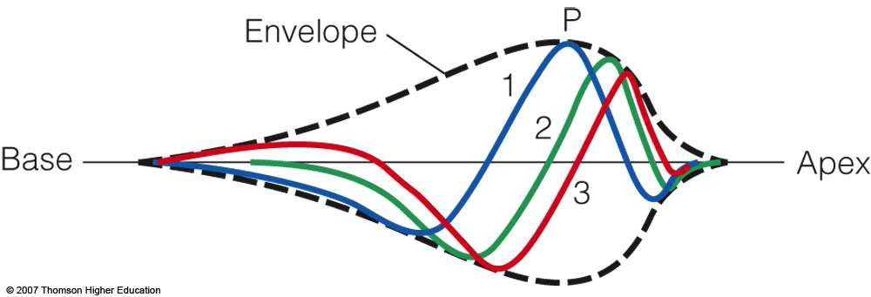
Békésys’ Place Theory of Hearing
Envelope of the traveling wave
Indicates the point of maximum displacement of the basilar membrane
Hair cells at this point are stimulated the most strongly leading to the nerve fibers firing the most strongly at this location
Position of the peak is a function of frequency

Slide 6
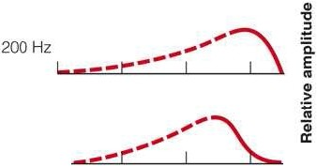
Base
Apex
25 Hz
50 Hz
I
400 Hz
I
Distance from stapes (mm)
© 2007 Thomson Higher Education

Slide 7
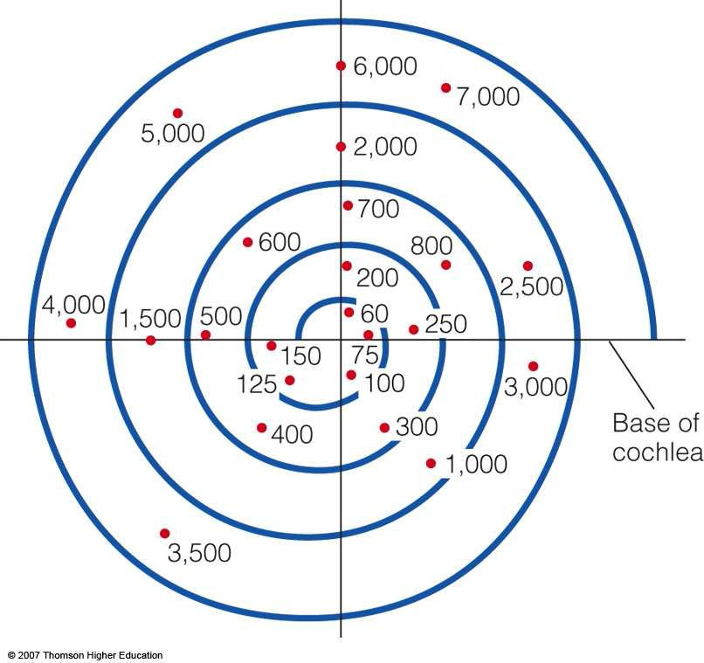
Evidence for Place Theory
Tonotopic map
Cochlea shows an orderly map of frequencies along its length
Base responds best to high frequencies
Apex responds best to low frequencies
Tonotopic map of the guinea pig cochlea.

Slide 8
Evidence for Place Theory
Neural frequency tuning curves
Pure tones are used to determine the threshold for specific frequencies measured at single neurons
Plotting thresholds for frequencies results in tuning curves
Frequency to which the neuron is most sensitive is the characteristic frequency

Slide 9
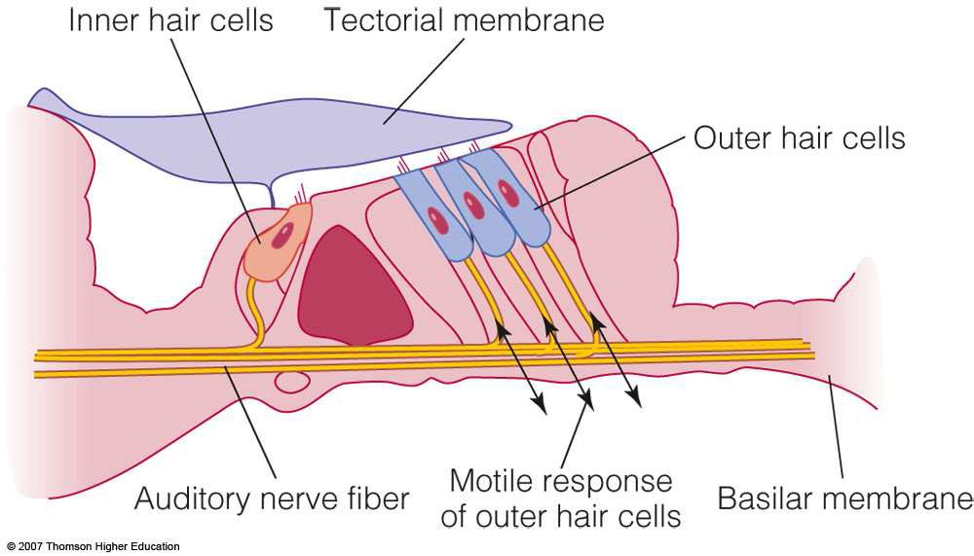
Updating Békésy’s Place Theory
Békésy used unhealthy basilar membranes and his results showed no difference in response for close frequencies that people can distinguish.
New research with healthy membranes show that the entire outer hair cells respond to sound by slight tilting and a change in length
– This is called the motile response and helps to amplify action on the membrane

Slide 10
Base
Apex
25 Hz
50 Hz
I
400 Hz
I
Distance from stapes (mm)
© 2007 Thomson Higher Education
-problem for place theory: no defined PoME below roughly 200-400 Hz, but clearly defined pitch perception can occur for those values

Slide 11
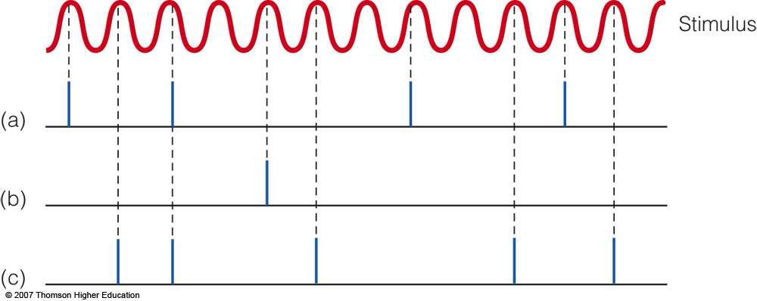
Temporal Theory
Phase locking
Nerve fibers fire in bursts
Firing bursts happen at or near the peak of the sine-wave stimulus
Thus, they are “locked in phase” with the wave
Groups of fibers fire with periods of silent intervals creating a pattern of firing

Slide 12
-problem for temporal theory: upper firing limits of neurons
-can be increased with the concept of phase locking and the volley principle
-however: phase locking breaks down at around 5000 Hz
-so, place theory handles 400Hz—20,000Hz,
-while temporal handles 20Hz —5,000Hz,
-overlapping in a specific region that has special properties:
-maximal sensitivity to intensity here (equal loudness contours)
-musical instruments found in this range
-sense of musical pitch found in this range

Slide 13
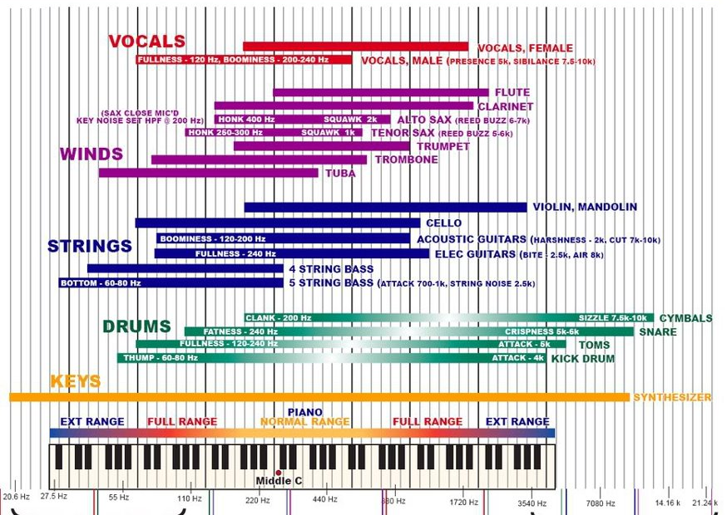

Slide 14
Pitch is also influenced by intensity
-lower frequencies (<1000Hz) perceived to decrease slightly in pitch as intensity increases (play example)
-higher frequencies (>2000Hz) perceived to increase in pitch as intensity increases (play example)
-between 1000-2000Hz, no change with intensity
-given that coding for loudness and coding for pitch both involve the firing rates of neurons, this isn’t actually a big surprise….

